Slide 1
Treatment
Venous Disease/Ulcer
S.Morrell NP MClSc-wound healing

Slide 2
Venous Ulcer: Treatment
Long healing time- approx. 30% unhealed at 24 weeks
Predictors of non-healing ulcers
Living alone
Compression level <30 mm Hg
Pressure Ulcer Scale for Healing (PUSH) score ≥10
Area reduction of <25% in two weeks
Calf-muscle dysfunction
Notes:
International validation of a venous leg ulcer risk assessment tool Parker et al. DOI: 10.12968/jowc.2023.32.4.229
(2017), Meulendijks et al. (2018)

Slide 3
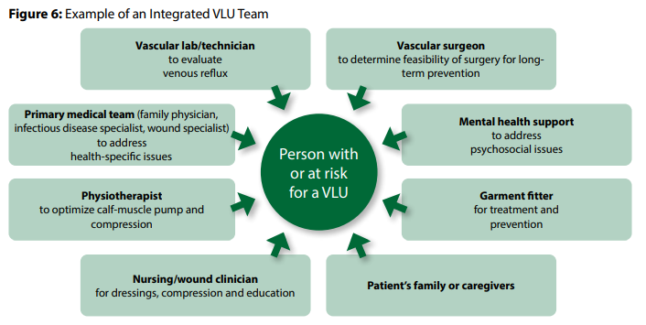
Treatment: Team Approach

Slide 4
Plan of Care: Compression
Evidenced Based: Compression
Venous insufficiency and/or lymphedema- life-long use
Forms-compression bandaging systems, compression garments or compression devices
Compression therapy- reduce ambulatory venous pressure
    Compression improves calf-muscle pump function
    Decreases reflux in incompetent veins

Slide 5
Plan of Care: Compression
Evidenced Based: Compression
Bandages and compression devices- used for treatment of active VLUs & reducing edema
Compression garments used once the edema is reduced- prevent recurrence of VLUs (classified as C3 to C6(Slide 18))

Slide 6
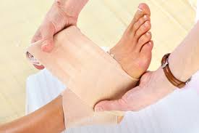
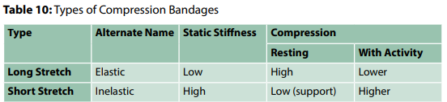
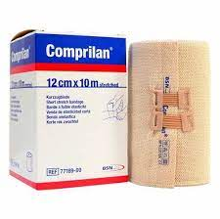
Plan of Care: Compression
Short-stretch bandages (SSB) (non-elastic)-muscle movement against rigid system- pressure is generated and distributed equally along the lower leg
SSB better for pain-
Massage effect with walking
More patients heal with high
compression stocking systems than SSB

Slide 7
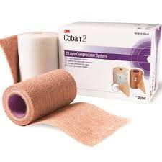
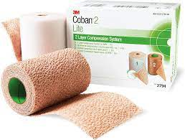
Short-stretch
Coban 2 Lite- 25–30mmHg ankle brachial pressure index equal to or greater than 0.5
Coban 2- 35–40mmHg brachial pressure index greater than or equal to 0.8.

Slide 8
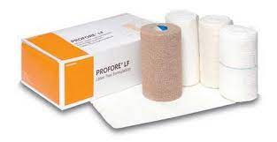
Plan of Care: Compression
Long-stretch -Multi-component systems more effective than those composed mainly of inelastic
Bulky- can decrease ROM
Profore-four-layer compression wrap elastic/long-stretch system providing high compression (30 - 40 mmHg) for up to 7 days
Two-layer perform as well as four-layer bandaging (4LB) systems.
4LB- heal faster than SSB

Slide 9
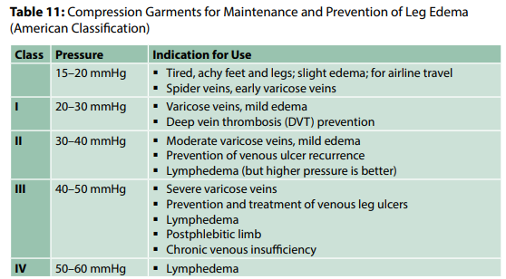
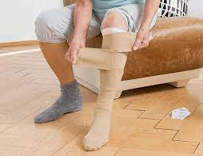
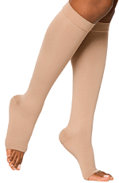
Plan of Care: Compression

Slide 10
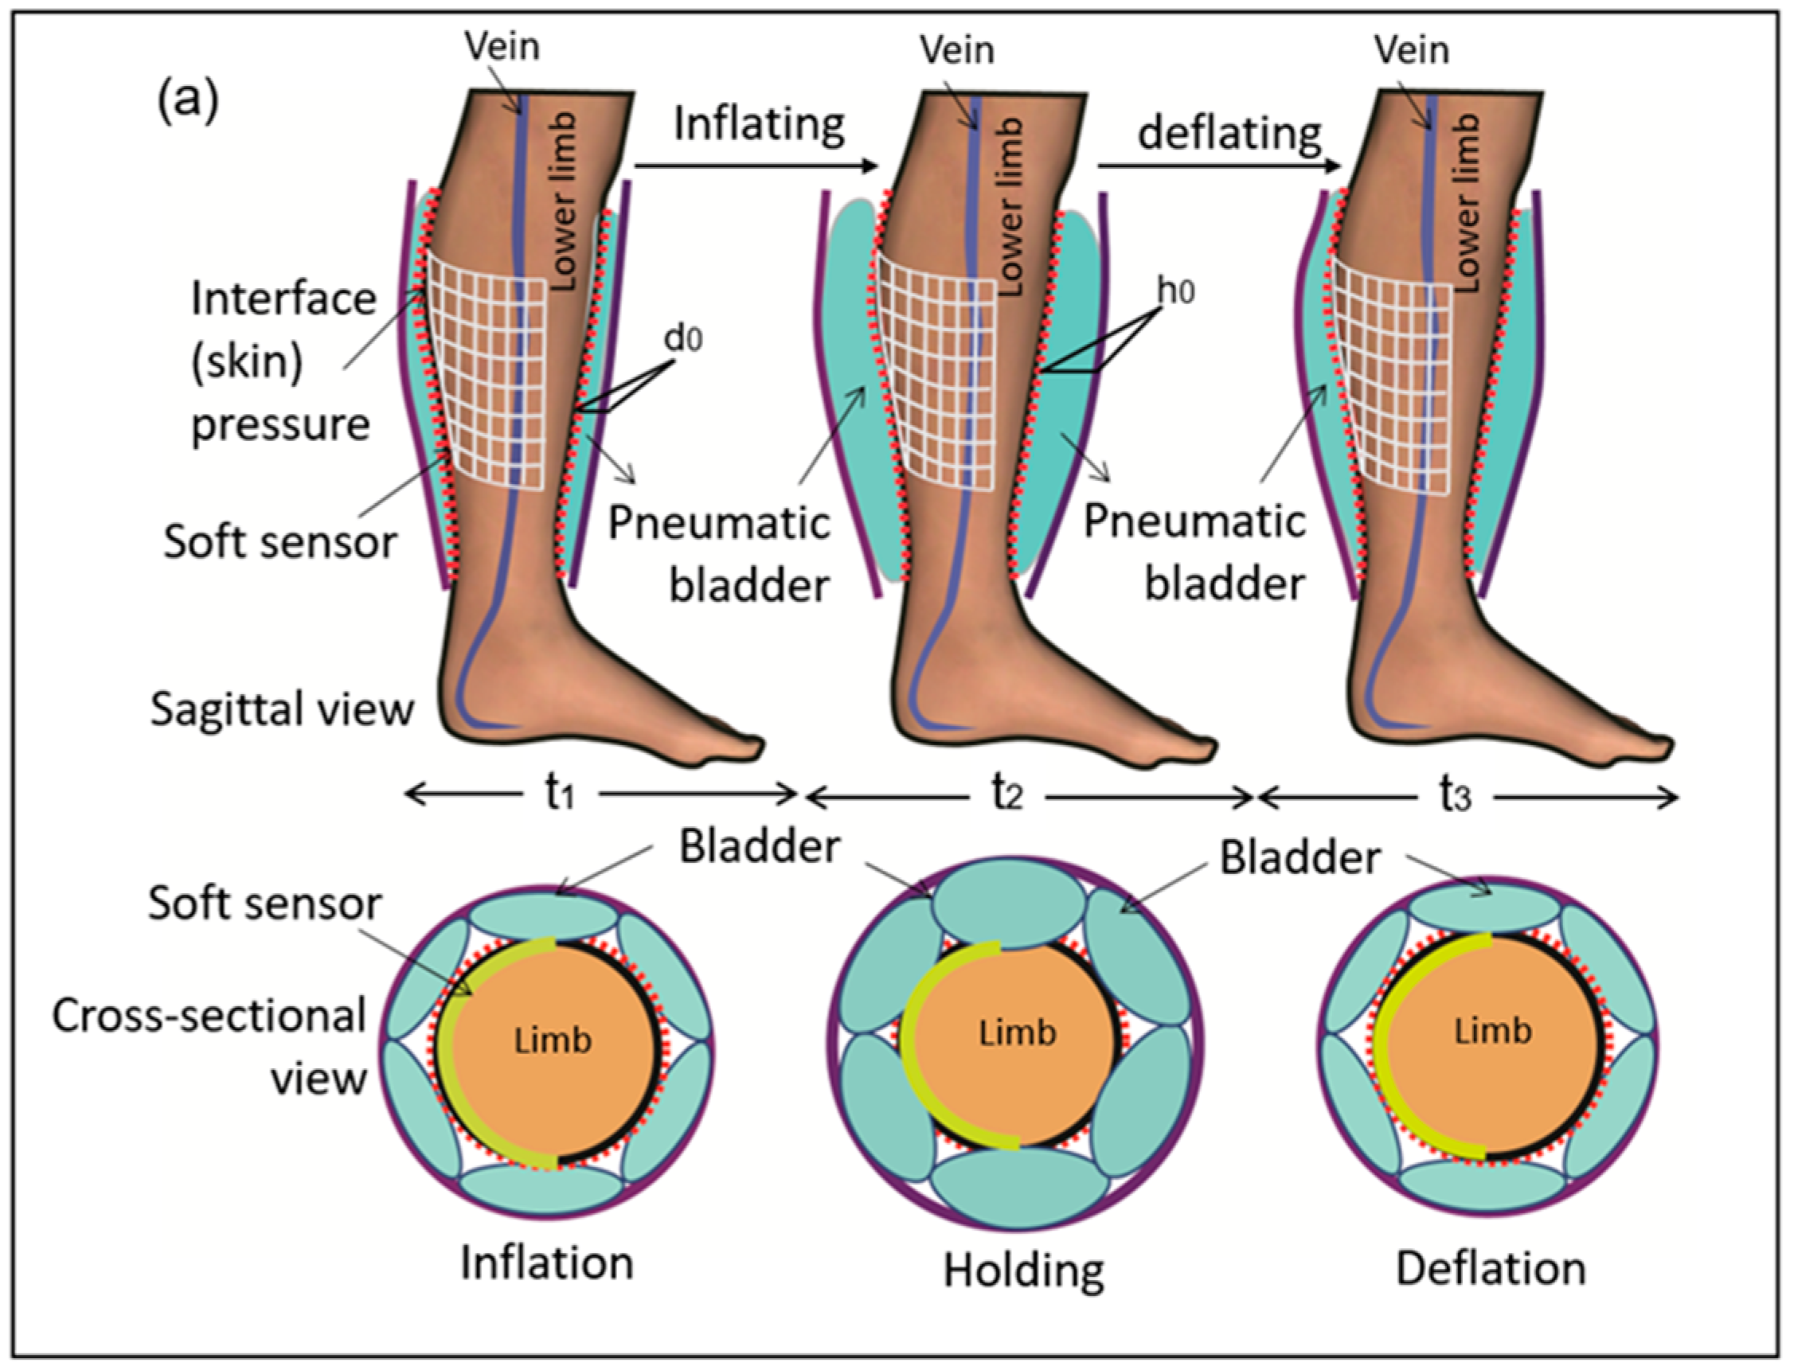
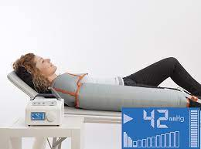
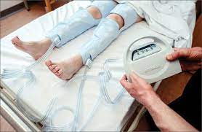
Plan of Care: Compression
Compression Devices
Intermittent pneumatic compression (IPC)- to reduce lower limb edema in VLUs & lymphedema
Notes:
Intermittent pneumatic compression- used in hospital to prevent DVT

Slide 11
Health Teaching
Venous Disease

Slide 12
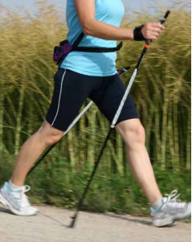
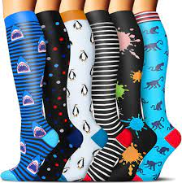
Health Teaching: Patients With Venous Disease
    Education on methods of decreasing venous pressure
    Less standing
    Less sitting- get up and walk each hour
    Walk daily (calf muscle)
    Leg exercises
    Compression stockings
    Elevate feet above heart

Slide 13
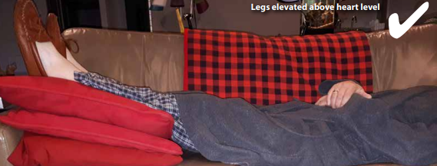
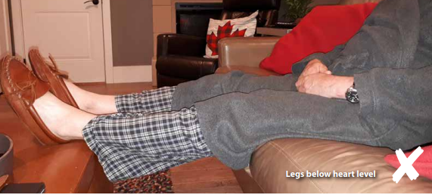
Elevation

Slide 14
Evaluation
Venous Disease

Slide 15
Avoid Recurrence
Recurrence rates- high as 70%
Ongoing, life-long compression required to prevent venous leg ulcer recurrence
Compression- underutilized- lack of clinician knowledge & unavailability of bandages/hosiery.
Ideal compression system should be:
 Affordable
 Comfortable
 Easy to apply
 Non-allergenic
 Able to fit into patient’s shoes

Slide 16
References
Orsted, H.L. & Rosenthal, S. (2021). Foundations of Best Practice for Skin and Wound Management. Wounds Canada. Ebook Available to purchase at https://www.woundscanada.ca/eboutique and the code for 25% discount on the ebook is UWNursing

